Slide 1
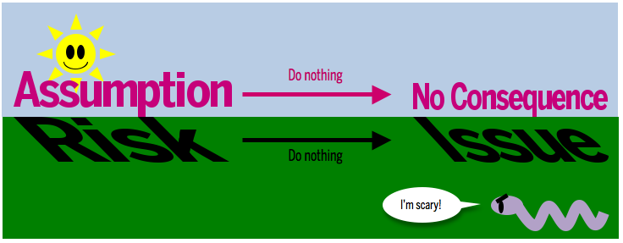

MSC3182
SOCIAL ENTREPRENEURSHIP
Lesson 4
RISKS AND ASSUMPTIONS

Slide 2
WHAT IS RISK?
We know that startups are highly uncertain, but uncertainty and risk aren’t the same thing.
We can be uncertain about a lot of things that aren’t risky.
Douglas Hubbard makes a clear distinction between the two in his book, How to Measure Anything (Wiley):
Uncertainty: The lack of compete certainty, that is, the existence of more than one possibility.
Risk: A state of uncertainty where some of the possibilities involve a loss, catastrophe, or other undesirable outcome.
Incorrect prioritization of risk is one of the top contributors of waste.

Slide 3
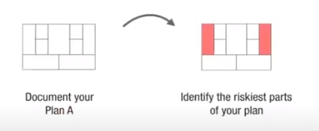
WHAT IS RISK?
The way you quantify risk in your business model is by quantifying the probabilities of a specific outcome along with quantifying the associated loss if you’re wrong.
This is a key step to prioritizing what’s riskiest on your business model and determining where to start.

Slide 4
CATEGOROZING RISK
Risks in a startup can be divided into three general categories,
Product risk
Getting the product right
Customer risk
Building a path to customers
Market risk
Building a viable business
Tackling all these risks at once can be overwhelming
Prioritize them based on the stage of your product, and
Tackle them systematically

Slide 5
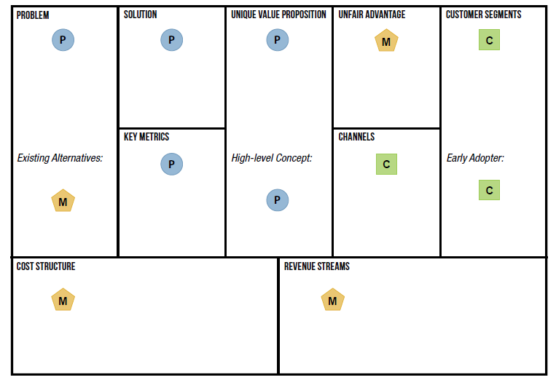
CATEGOROZING RISK

Slide 6
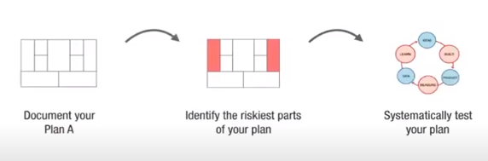
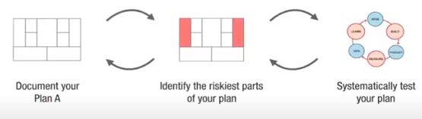
TEST YOUR PLAN

Slide 7

TEST YOUR PLAN

Slide 8

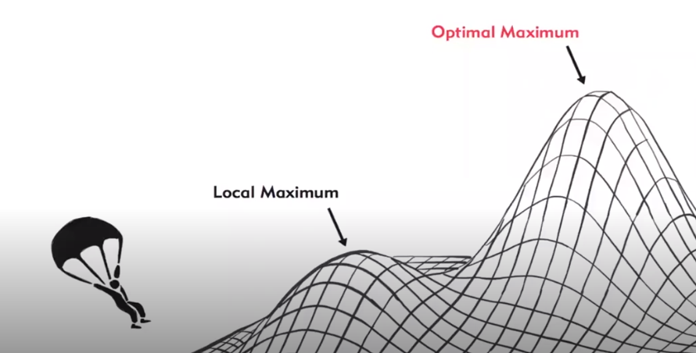
TEST YOUR PLAN

Slide 9

TEST YOUR PLAN

Slide 10
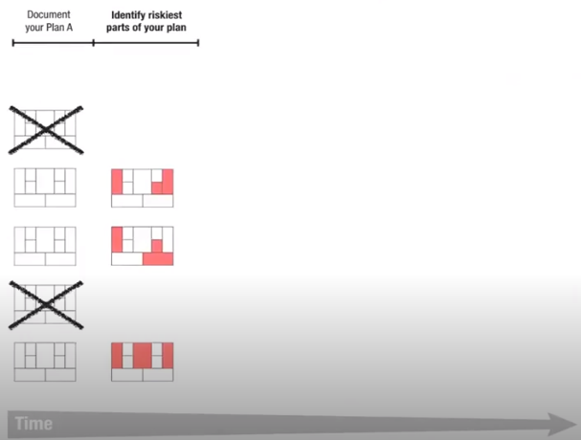
TEST YOUR PLAN

Slide 11
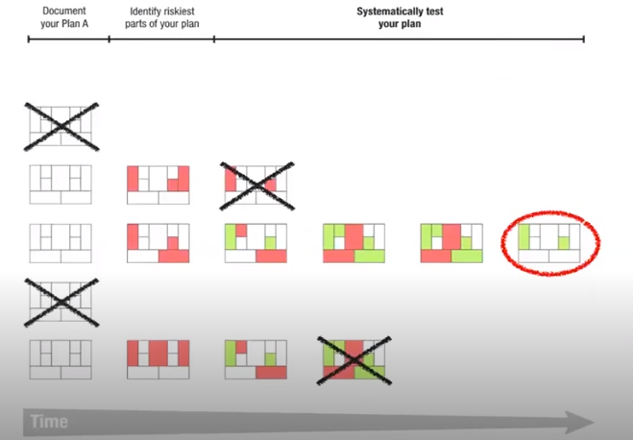
TEST YOUR PLAN

Slide 12
SEEK EXTERNAL ADVICE
Another effective technique for further calibrating your risks is getting out of the building and validating them with people other than yourself.
It is imperative that you share your model with at least one other person.
Prefer to first spend a little additional time prioritizing risks and brainstorming alternative models with people other than customers—e.g., advisors.
The reason is to maximize speed and learning.
Customers cannot directly give you all the answers, and due to the iterative and qualitative nature of early learning, validating hypotheses takes time.

Slide 13
SEEK EXTERNAL ADVICE
The “right” advisors, on the other hand, can help you identify risks on the “total plan” and help you to further refine and/or outright eliminate some models.

